Slide 1
Ethics and Ethical Theories

Slide 2
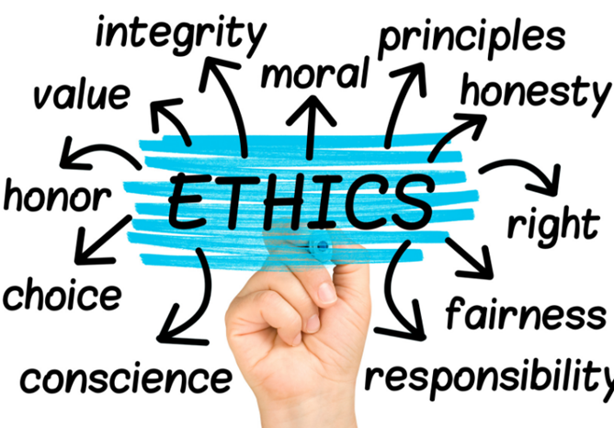
Topics to be covered
Ethics
Ethical Theories
Subjective Relativism
Cultural Relativism
Divine Command Theory
Ethical egoism
Kantianism
Act utilitarianism
Rule utilitarianism
Social contract theory
Virtue ethics
Comparing workable ethical theories
Morality of breaking the law
Notes:
In this chapter we
describe the difference between morality and ethics, discuss a variety of ethical theories,
evaluate their pros and cons, and show how to use the more viable ethical theories to
solve moral problems.

Slide 3
What is Ethics?
Ethics: A code of behavior defined by the group to which an individual belongs
Morals: Personal principles upon which an individual bases his or her decisions about what is right and what is wrong
Virtue: A habit that inclines people to do what is acceptable( Generosity, loyalty)
Vice: A habit of unacceptable behavior(Greed, Envy, anger)

Slide 4
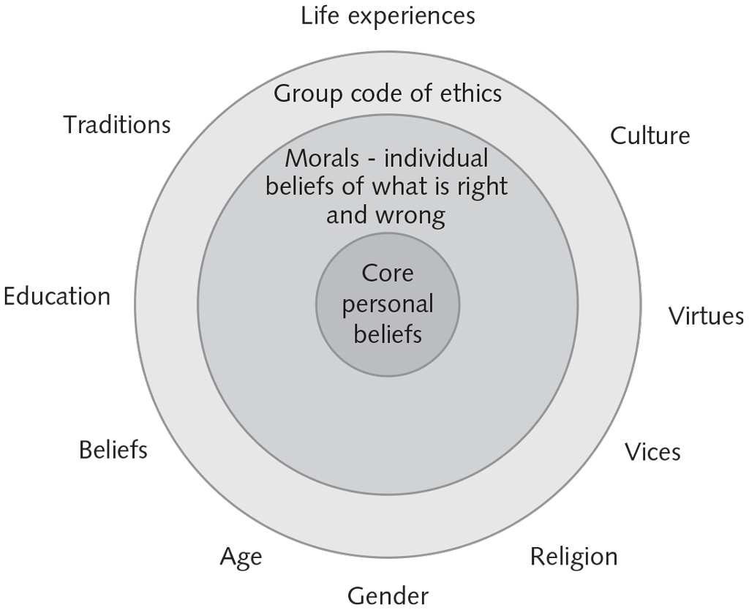
The Relationship Between Ethics and Morals

Slide 5
Difference Between Morals, Ethics, and Laws
Morals | Ethics | Law
Personal principles an individual uses to determine what is right and what is wrong Moral acts conform to what an individual believes to be the right thing to do | Code of behavior that is defined by the group to which an individual belongs | System of rules, enforced by a set of institutions, that tells us what we can and cannot do Legal acts are acts that conform to the law

Slide 6
The Ethical Point of View
Everyone shares “core values”, desiring:
  Life
  Happiness
  Ability to accomplish goals
Two ways to view world
  Selfish point of view: consider only your own self and your core values
  Ethical point of view: respect other people and their core values

Slide 7
Analogy: Difference between Morality and Ethics
An analogy explaining the difference between ethics and morality. Imagine society as a town.
Morality is the road network within the town. People doing ethics are in the balloons floating above the town.

Slide 8

Why Study Ethics?
Ethics: a way to decide the best thing to do
New problems accompany new technologies
“Common wisdom” may not exist for situations brought about by new technologies

Slide 9
Definition of Ethics
In general Ethics is the philosophical study of morality, a rational examination into people’s moral beliefs and behavior.
Ethics is a set of moral principles that govern the behavior of an individual or group of people. Computer ethics is the application of moral principles to the use of computers and the Internet.
Examples include intellectual property rights, privacy policies, and online etiquette, or "netiquette“
https://youtube/u399XmkjeXo

Slide 10

A Good Ethical Theory Enables You to Make Persuasive, Logical Arguments
Notes:
In the past two millennia, philosophers have proposed many ethical theories. In this chapter we review some of them. How do we decide if a particular theory is useful? A
useful theory allows its proponents to examine moral problems, reach conclusions, and defend those conclusions in front of a skeptical, yet open-minded audience (

Slide 11
Ethical Theories
Subjective Relativism
Cultural Relativism
Divine Command Theory
Ethical egoism
Kantianism
Act utilitarianism
Rule utilitarianism
Social contract theory
Virtue ethics
Notes:
In the following sections we consider nine ethical theories—nine frameworks for moral decision making. We present the motivation or insight underlying each theory,
explain how it can be used to determine whether an action is right or wrong, and give the “case for” and the “case against” the theory. The workable theories will be those
that make it possible for a person to present a persuasive, logical argument to a diverse audience of skeptical, yet open-minded people.

Slide 12
Subjective Relativism
Each person decides right and wrong for himself or herself
“What’s right for you may not be right for me”
Conclusion: Not a workable ethical theory
Cultural Relativism
What is “right” and “wrong” depends upon a society’s actual moral guidelines
These guidelines vary from place to place and from time to time
Conclusion: Not a workable ethical theory
Divine Command Theory
Good actions are those aligned with God’s will
Bad actions are those contrary to God’s will
Conclusion: Not a workable ethical theory for our purposes
The principal sources for these brief introductions to ethical theories are Ethical
Insights: A Brief Introduction by Douglas Birsch [4], The Elements ofMoral Philosophy by
James Rachels [5], and On Virtue Ethics by Rosalind Hursthouse [6].

Slide 13
Ethical Egoism:
Each person should focus exclusively on his or her self-interest
Morally right action: that action that provides self with maximum long-term benefit
Conclusion: Not a workable ethical theory
Kantianism: (Immanuel Kant)
Kant believed that people’s actions ought to be guided by moral laws, and that these moral laws were universal.
Our focus should be on what we ought to do. Our sense of “ought to” is called dutifulness.
For Kant, an imperative is a way in which reason commands the will.
There are two kinds of imperatives: hypothetical and categorical, however, only a categorical imperative can be a moral imperative.
Conclusion: Despite weaknesses, a workable ethical theory
https://youtu.be/-UhiRLuSlIU
Notes:
In sharp contrast to the divine command theory, which promotes a concern for others
with scriptural injunctions such as “Love your neighbor as yourself“Love your neighbor as yourself,”

Slide 14
Categorical Imperative
(First Formulation)
you should act only on moral rules that you can imagine everyone else following without deriving a logical contradiction.
When evaluating a proposed action, reverse roles
What would you think if that person did the same thing to you?
If you have a negative reaction → evidence that your will to do that action violates the Categorical Imperative

Slide 15
Categorical Imperative
(Second Formulation)
Act so that you treat both yourself and other people as ends in themselves and never only as a means to an end.
every interaction with other people must give them the dignity and respect they deserve as autonomous, rational beings.
Kantian analysis of the moral problem focuses on the will behind the action
The analysis ignores extenuating circumstances that non-Kantians may cite to justify an action

Slide 16
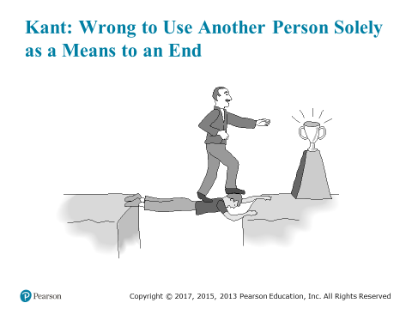

Slide 17
Act Utilitarianism:The English philosophers Jeremy Bentham (1748–1832) and John Stuart Mill (1806–1873) proposed a theory that is in sharp contrast to Kantianism.

Slide 18
Act Utilitarianism:
Principle of Utility
An action is good if its benefits exceeds its harms
An action is bad if its harms exceed its benefits
Utility: tendency of an object to produce happiness or prevent unhappiness for an individual or a community
Happiness = advantage = benefit = good = pleasure
Unhappiness = disadvantage = cost = evil = pain
Conclusion: Overall, a workable ethical theory
https://www.youtube.com/watch?v=mL7Pt-NHraU

Slide 19
Principle of Utility

Slide 20
Topics to be covered
Ethics
Ethical Theories
Subjective Relativism
Cultural Relativism
Divine Command Theory
Ethical egoism
Kantianism
Act utilitarianism
Rule utilitarianism
Social contract theory
Virtue ethics
Comparing workable ethical theories
Morality of breaking the law

Slide 21
Rule utilitarianism
Is the ethical theory that holds that we ought to adopt those moral rules that, oif followed by everyone, lead to the greatest increase in total happiness ver all affected parties.
Conclusion: Despite weaknesses, both act utilitarianism and rule utilitarianism are workable ethical theories
https://youtu.be/d1R1X9sV9YQ
Social Contract Theory
Social contract theory says that people live together in society in accordance with an agreement that establishes moral and political rules of behavior.
Hobbes, Locke, and many other philosophers of the seventeenth and eighteenth centuries held that all morally significant beings have certain rights, such as the right to life, liberty, and property.
https://youtu.be/UY3aMtMkoEU

Slide 22
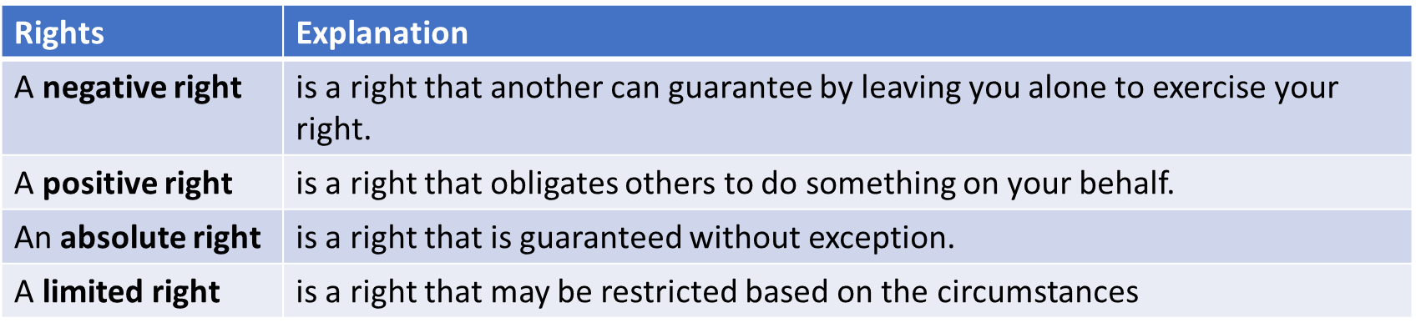
Rights and Duties

Slide 23
Virtue Ethics
Virtue ethics is person rather than action based: it looks at the virtue or moral character of the person carrying out an action, rather than at ethical duties and rules, or the consequences of particular actions. ... A good person is someone who lives virtuously - who possesses and lives the virtues.(Google)
A good person does “the right thing at the right time for the right reason”(Virtue Analysis)
Two types of virtues:
  intellectual virtues: virtues associated with reasoning and truth
  moral virtues: virtues of character (a deep seated character trait, e.g., honesty)

Slide 24
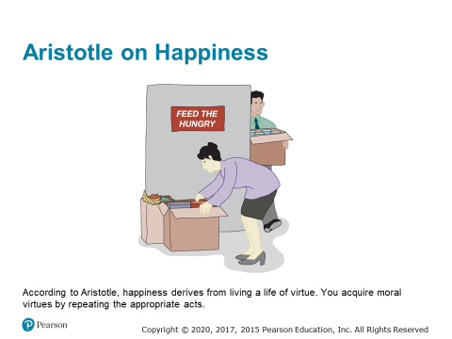

Slide 25
Vices
A vice is a character trait that prevents a human being from flourishing or being truly happy.
Aristotle noticed that in many cases two different vices can be associated with a virtue: one corresponding to an excess and the other corresponding to a deficiency.
Example: The virtue of friendliness is somewhere in between quarrelsomeness (being too critical of what others like or what they want to do) and obsequiousness (giving in too easily and not being critical enough of what others like or what they want to do)
https://youtu.be/qs9QiczZvdU

Slide 26
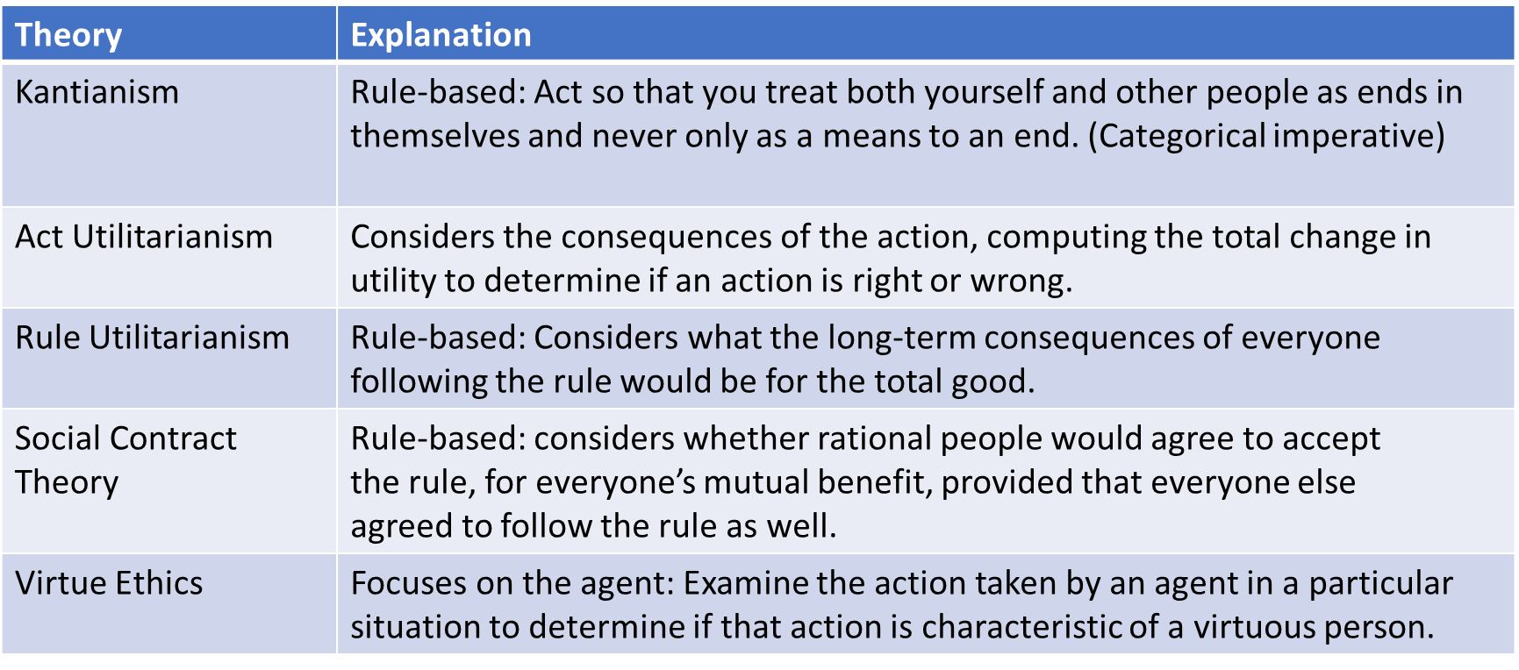
Comparing Ethical Theories
(Potentially Workable Theories)

Slide 27
Workable Ethical Theories
Workable ethical theories
Kantianism
Act and rule utilitarianism
Social contract theory
Virtue ethics

Slide 28
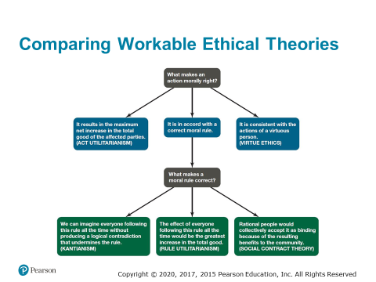

Slide 29
Insights Offered by Various Theories (1 of 2)
Kantianism: Every person is equally valuable, and when you interact with other people you should always respect them as rational beings. It is wrong to privilege your needs and desires over those of other people.
Utilitarianism: You should consider the consequences of an action before deciding whether it’s right or wrong.

Slide 30
Insights Offered by Various Theories (2 of 2)
Social contract theory: We should collectively promote human rights, such as the rights to life, liberty, and property.
Virtue ethics: You can count on a good person to do the right thing at the right time in the right way.

Slide 31
It’s up to You
You can consider duties and rights and consequences and virtues when making moral decisions
Ultimately, you have to decide:
  What kind of person do I want to be?
  What kind of world do I want to live in?

